Slide 1
Gordon College Uniform Reservation Group: Code Us

Slide 2
Description
Gordon College Uniform Reservation is a private website only for students of Gordon College Olongapo City. This allows students to reserve uniform through this website. They can access this site and login their account by their corresponding student ID and given password by the admin which is us the creator of the website. This will minimize the physical contact of student to other students especially right now there are covid-19.

Slide 3
CUSTOMER SEGMENTS
Our target customers are:
- Gordon College Students
- Mass market target
Notes:
Adasdadadadasd
asdasdasdasdas

Slide 4
VALUE PROPOSITIONS
Gordon College Uniform Reservation: “Reserve now. Pay & get later.”
Product: Gordon College Uniform Reservation
Target Market: Students of Gordon College.
Primary Benefit: Online reservation of uniform, friendly user interface & no need to go to school to reserve you can do it through online.
What makes it unique? Gordon College Uniform Reservation is an private website for students of GC. The design and the simple process of reserving uniforms is the uniqueness of this site.

Slide 5
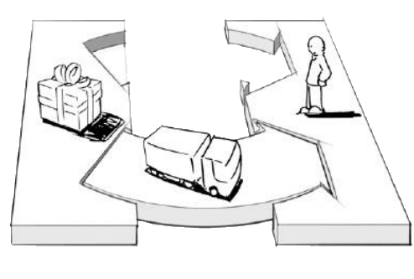

CHANNELS
- Word of mouth
- Social Media Page (GC)
- Poster

Slide 6

CUSTOMER RELATIONSHIPS
- User Friendly interface
- Accessible and Reliable
- Assistance
- Feedback

Slide 7
REVENUE STREAMS
- Free access but only for students of GC.
- Can earn profits from making advertisements in social media sites.

Slide 8
KEY RESOURCES
Human Resources -Partnership, uniform supplier, employees and developers.
Financial Resources – for web application needs.
Intellectual Resources – customer databases.

Slide 9
KEY ACTIVITIES
Service – Reservation of uniform.
Problem Solving – creating solutions for our user encountered problems in the site.

Slide 10
KEY PARTNERS
Our website key partners are:
Gordon College COOP - They are the one who will acquire reservations and Update the announcement through Social Media page if the uniforms are ready to get.
Gordon College Head - The one who will confirm and check all the reserve uniforms through GC Admin Reserve List.
Co-Information Technology partner – group members.

Slide 11

COST STRUCTURE
- Web application development costs
- Advertisement expenses (Poster)
- Server/deployment costs (if deployed)

Slide 12
THANK YOU !

